Slide 1


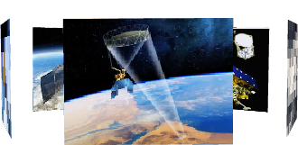
The extraordinarily large vortex structure of Typhoon In-fa (2021), observed by spaceborne microwave radiometer and synthetic aperture radar
Ziyao Sun ^{1,2}
¹Shanghai Typhoon Institute, China Meteorological Administration, Shanghai, China
²Asia-Pacific Typhoon Collaborative Research Center, Shanghai, China
ESCAP/WMO Typhoon Committee 18th Integrated Workshop / 4th TRCG Forum，Bangkok, Thailand，28 November - 1 December 2023

Slide 2
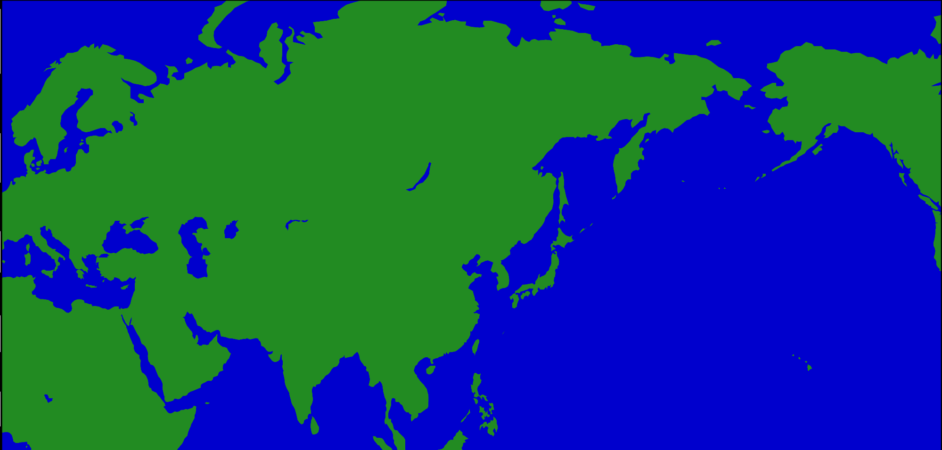
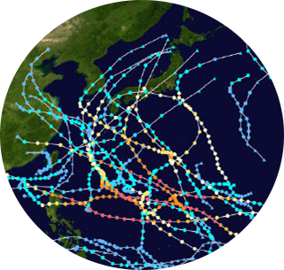
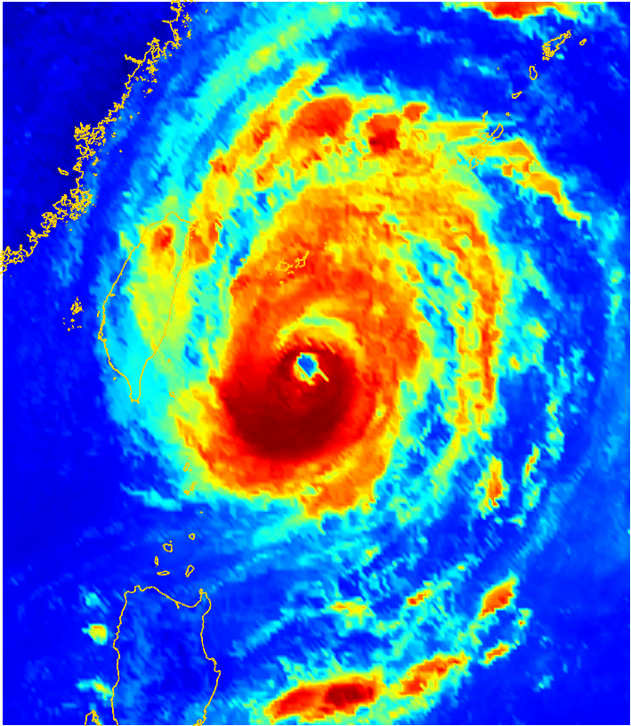
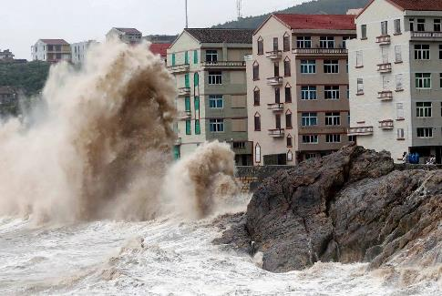
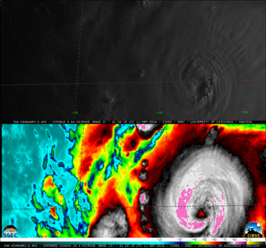

Background and motivation

Slide 3
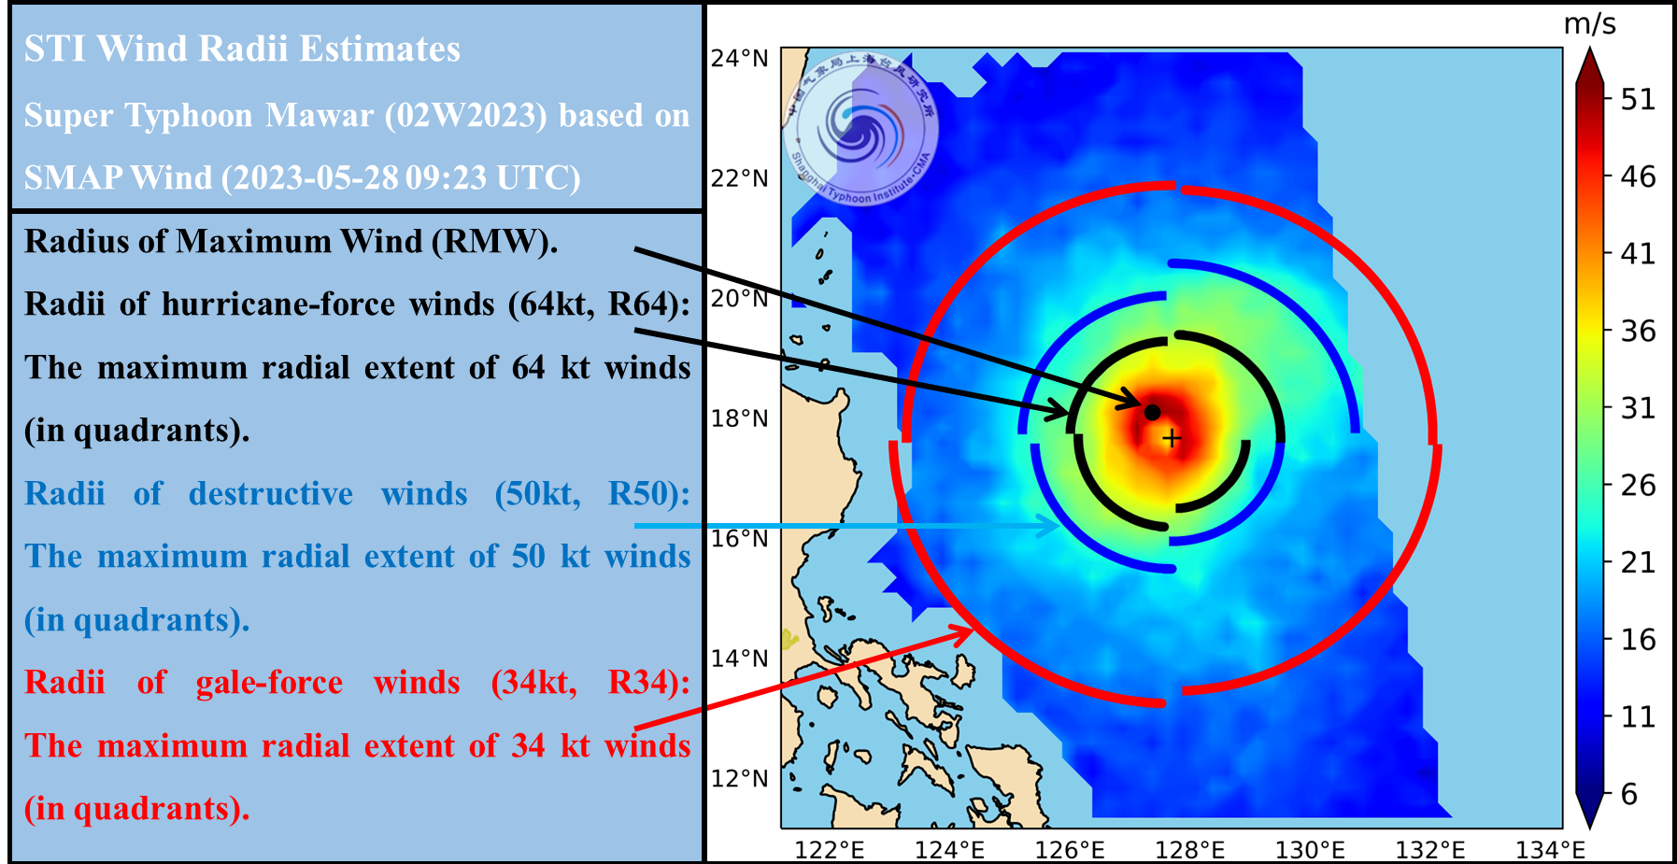
Background and motivation

Slide 4
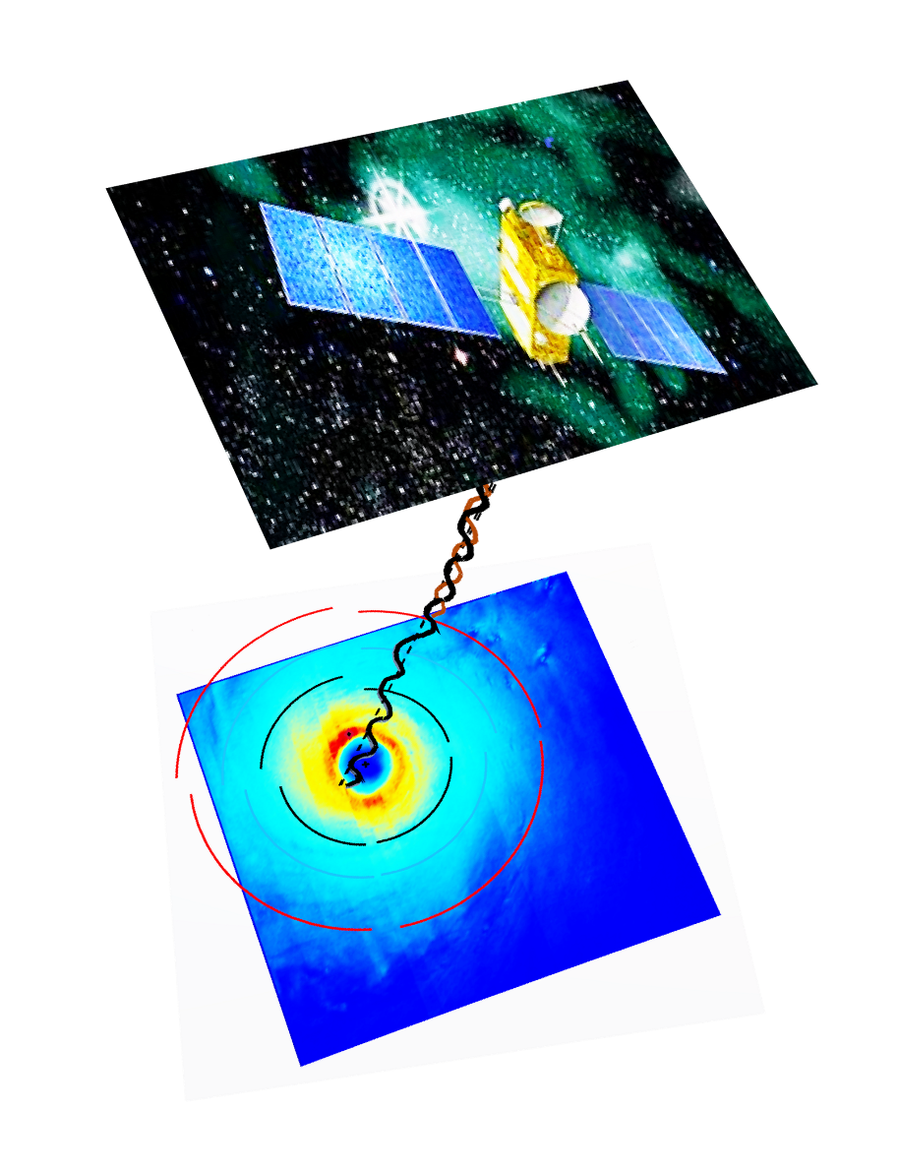

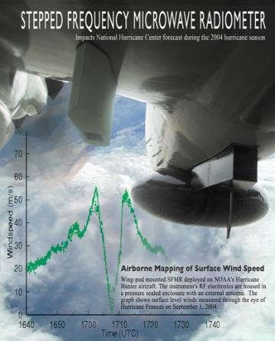
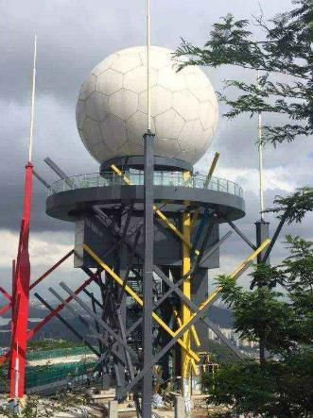
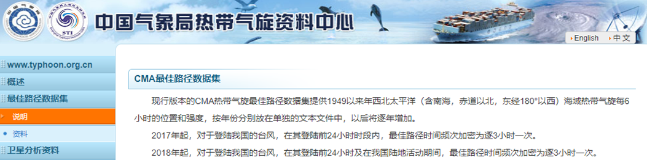
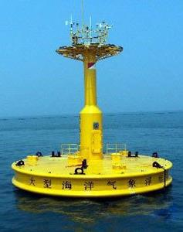
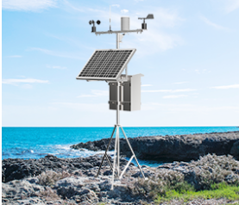
Background and motivation
Joint Typhoon Warning Center（JTWC） TC Best Track Dataset
In situ observations
Doppler radar
Since 2001, the U.S. JTWC has been providing scale information for TCs in the WNP. Post-storm analysis of R34 for WNP TCs began in 2016 and in recent years, JTWC real-time and post-storm analysis has utilized wind field products from SMAP, AMSR2, and SAR .(Howell et al., 2022)
SFMR
Satellite Remote Sensing has become the most widely used method of estimating wind radii !
China Meteorological Administration(CMA) TC Best Track Dataset
Ocean buoys
AWS
The STI, CMA TC Best Track Dataset includes track information for TCs in the WNP. Currently, this dataset provides a set of TC scale dataset based on geostationary infrared satellite imagery (1980-2016) (Ying et al., 2014, Lu et al., 2017).

Slide 5
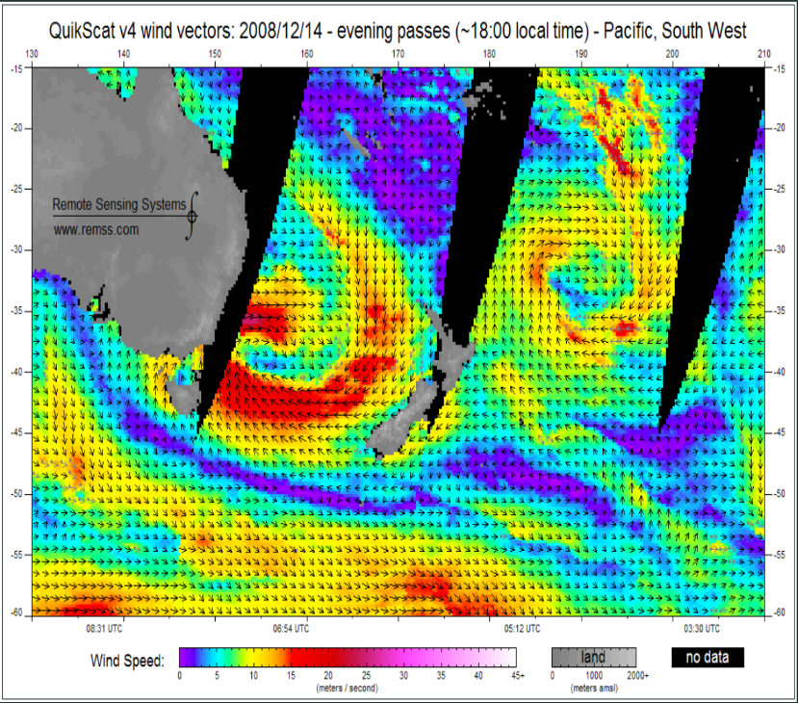
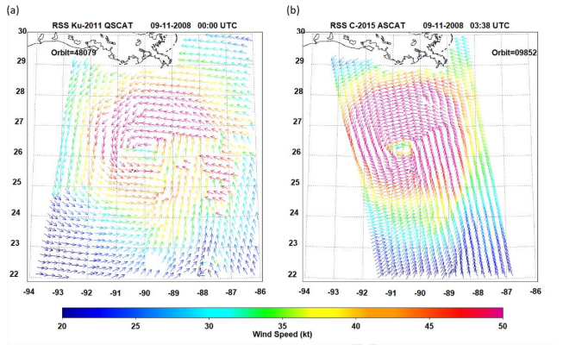
Background and motivation
Scatterometers are primary sources of surface winds for TC forecast operations. Due to rainfall attenuation and signal saturation, Scatterometers can only provide maximum wind speeds in the eyewall region of most TCs in the range of 60-70kts.(Brennan et al., 2009; Ricciardulli and Wentz, 2015; Stoffelen et al.,2017a)
al., 2017a)).
Ku-band
C-band
（Knaff et al. 2021）

Slide 6
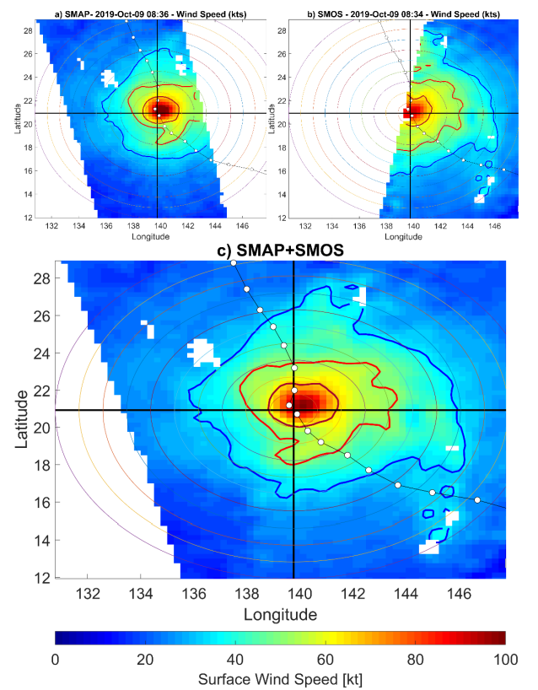
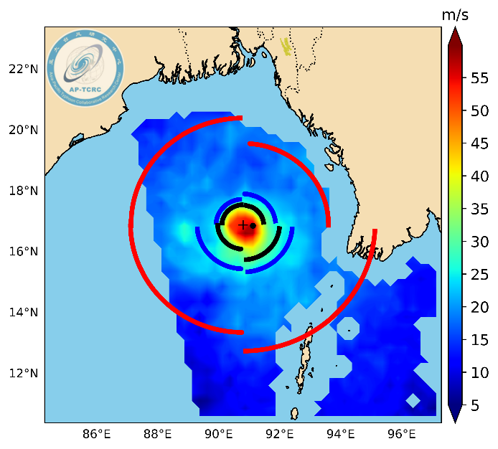
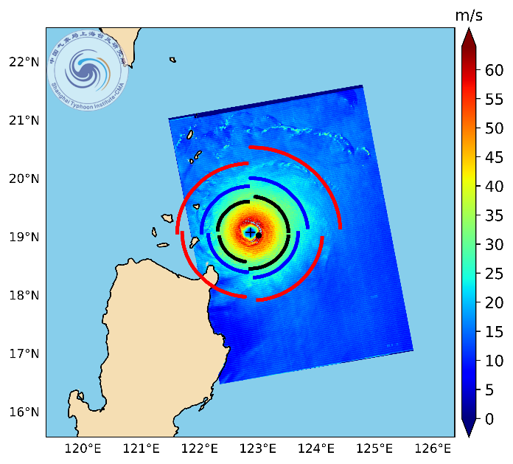
Background and motivation
L-band radiometer such as SMAP has capability of measuring high wind speed up to 150 kts with good accuracy. (Yueh et al., 2016；Fore et al. , 2018). Spaceborne synthetic aperture radars (SARs) have higher spatial resolutions and can provide precise measurements of TC sea-surface wind fields under severe weather conditions (Zhang et al., 2012, 2014; Mouche et al., 2019).
SMAP
RCM
（Knaff et al., 2021）

Slide 7
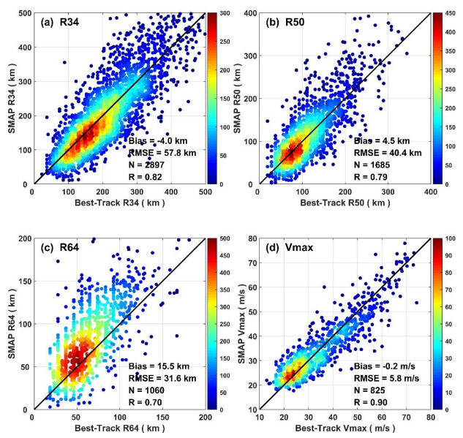
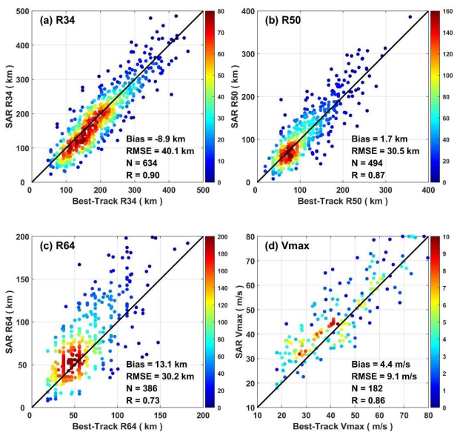
Background and motivation
The radiometer (SMAP) and SAR (Sentinel-1 and RADARSAT-2)-derived wind radii are systematically compared with the best-track estimates (IBTrACS). These error values are smaller than the averaged best-track uncertainty estimates for the three wind radii. (Zhang et al., 2021).
SMAP DATA
SAR DATA

Slide 8
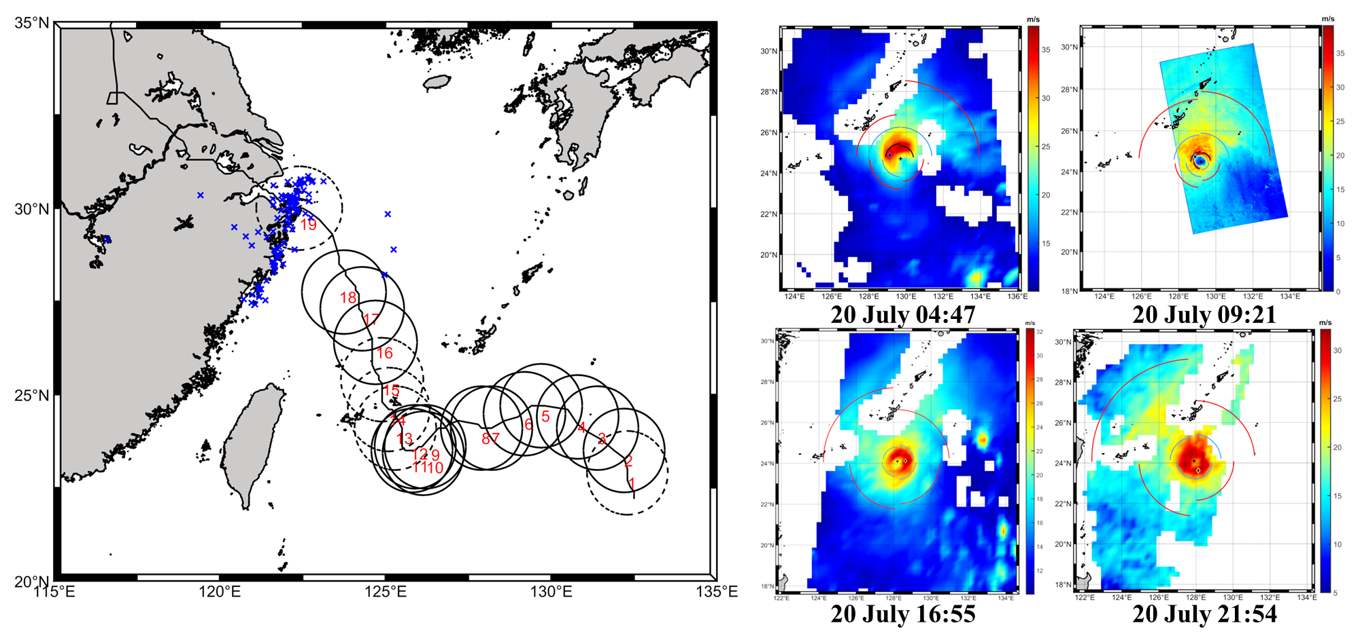
Background and motivation
Multi-source microwave remote sensing observation can provide multi-temporal wind fields.
AMSR2
SAR
AMSR2
SMAP
（ Sun et.al，2023）

Slide 9
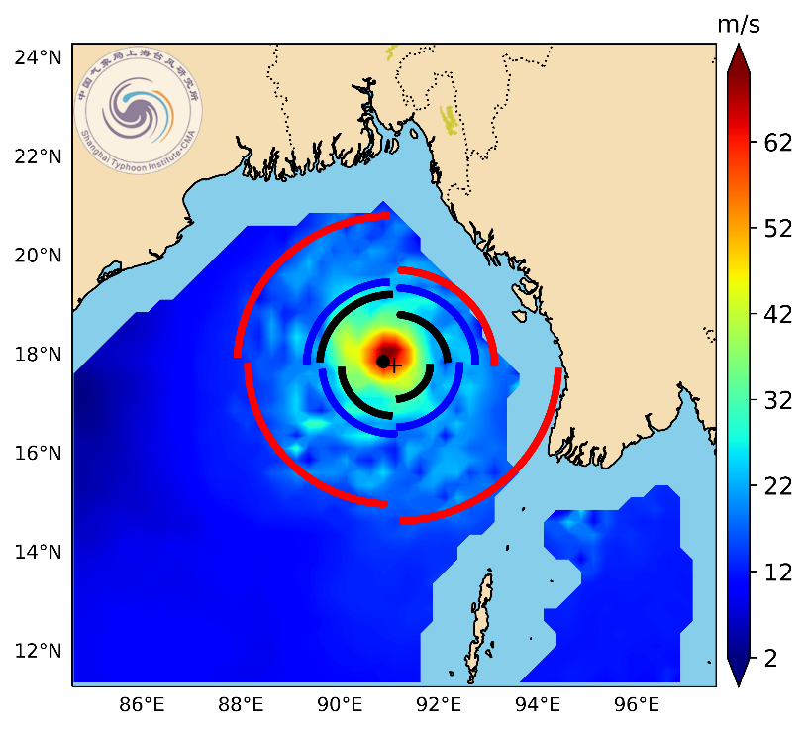
Wind Radius Detection Technology
Flowchart of TC wind radii detection process

Slide 10
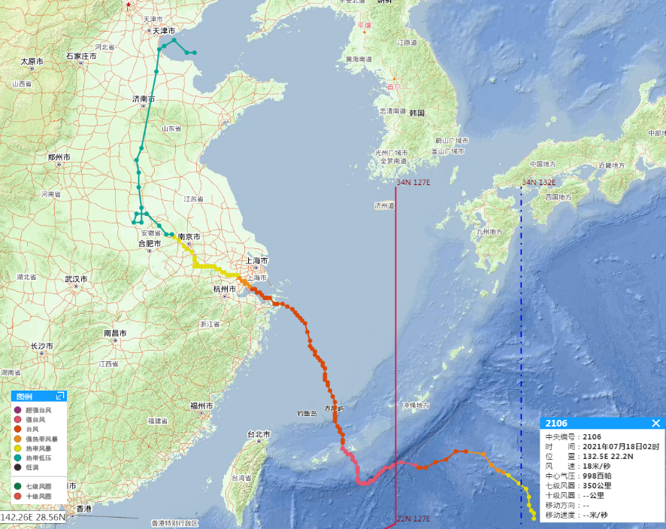
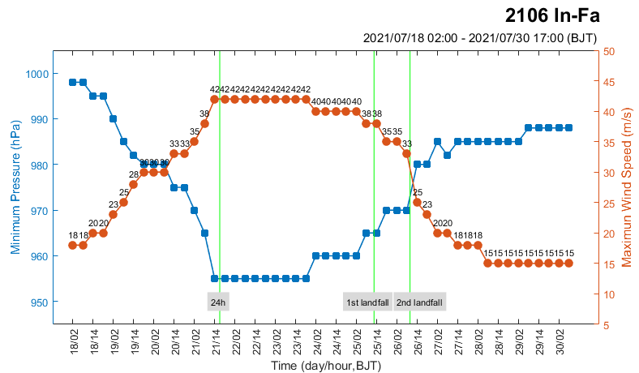
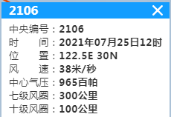
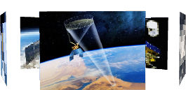
Life history of Typhoon IN-FA
In-fa developed over the open ocean on July 18.
It made landfall on Zhoushan island of Zhejiang province at 04:30 UTC on July 25 with a MWS of 38 m/s in CMA dataset.
Screenshot from Western North Pacific Tropical Cyclone Retrieval System，STI
25 July
First landfall
18 July
Generation
The intensity of In-fa from CMA
The track of In-fa from CMA

Slide 11
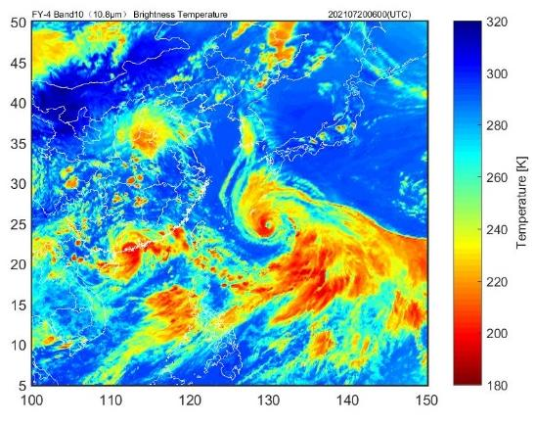
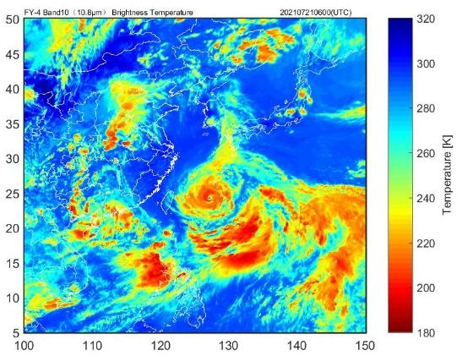
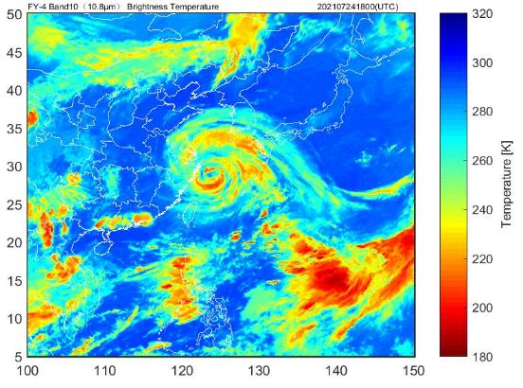
Structure of Typhoon IN-FA
On July 21-22, In-fa reached its maximum intensity (42 m/s, severe typhoon level) in the ocean east of Taiwan, China.
The brightness temperature of Fy-4 shows that the convection of In-fa developed vigorously. The main cloud system is symmetrical and close. The cloud top temperature is low and the spiral structure is complete. We can see the clear typhoon eye.
Before the landfall, the cloud system still maintained an aboriginal spiral shape with a wide range(maximum radius~350km)
In-fa exhibited many notable features during its evolution, such as large wind radii, a considerable eye, a concentric eyewall (CE) structure, slow movement, a sharp northwestward turn, and widespread wind and rain.
20 July 06:00（33m/s）
21 July 06:00（42m/s）
24 July 18:00
（40m/s，before landfall）

Slide 12
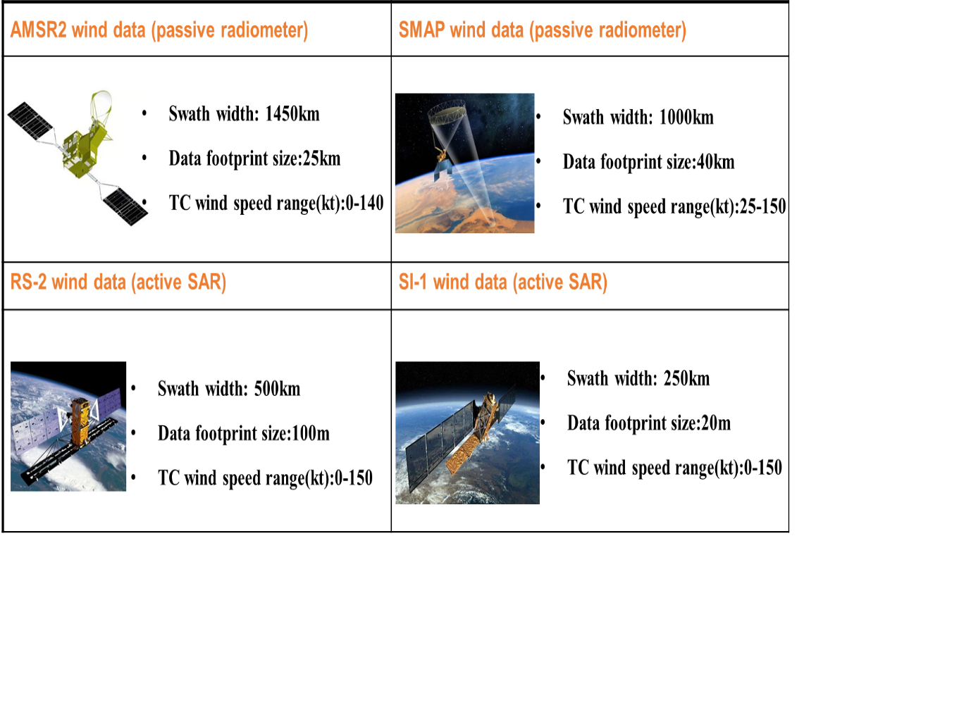
Multi-source microwave remote sensing instruments
Serial Number | Instrument | Acquisition time (UTC)
(1) | SMAP | 0836 UTC 18 July
(2) | AMSR2 | 1707 UTC 18 July
(3) | SMAP | 0912 UTC 19 July
(4) | SMAP | 2118 UTC 19 July
(5) | AMSR2 | 0447 UTC 20 July
(6) | RS-2 | 0921 UTC 20 July
(7) | AMSR2 | 1655 UTC 20 July
(8) | SMAP | 2154 UTC 20 July
(9) | AMSR2 | 1739 UTC 21 July
(10) | Sl-1A | 2136 UTC 21 July
(11) | AMSR2 | 0435 UTC 22 July
(12) | SMAP | 0924 UTC 22 July
(13) | SMAP | 2130 UTC 22 July
(14) | AMSR2 | 0518 UTC 23 July
(15) | AMSR2 | 1726 UTC 23 July
(16) | SMAP | 2206 UTC 23 July
(17) | AMSR2 | 0424 UTC 24 July
(18) | Sl-1A | 0954 UTC 24 July
(19) | AMSR2 | 0507 UTC 25 July
We used seven SMAP, nine AMSR2, one RS-2 and two Sl-1A sea-surface wind field observation samples from July 18 to July 25 to study the evolution of the wind field structure in Typhoon In-fa. Table shows the acquisition time for each sample.

Slide 13
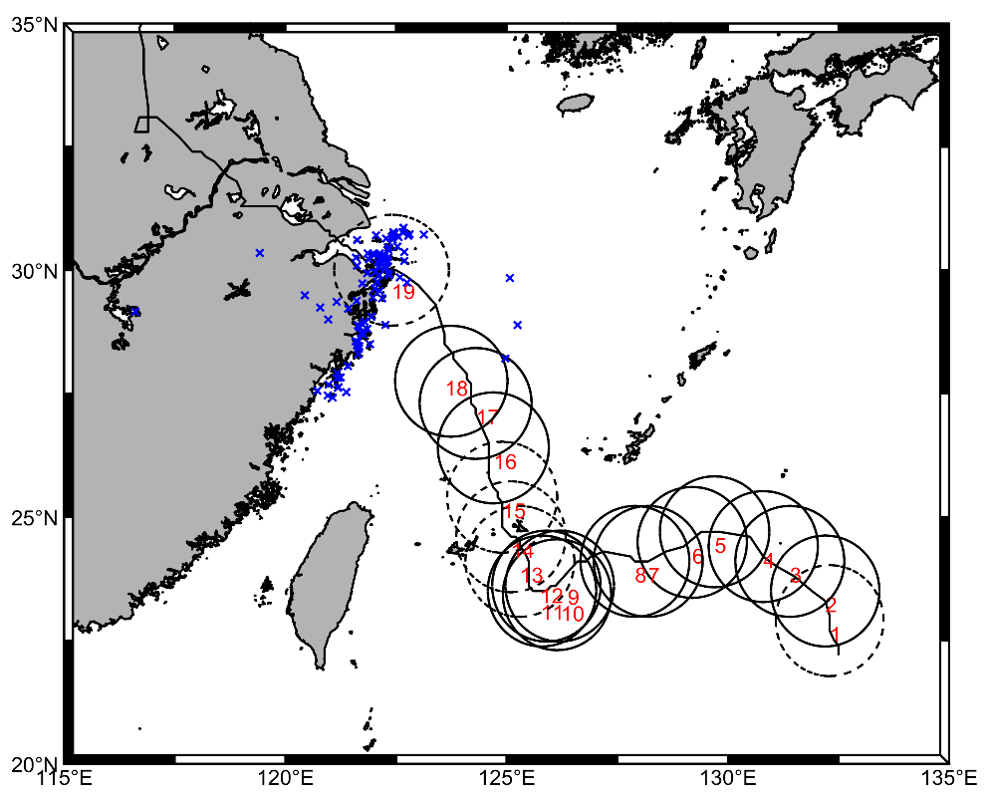
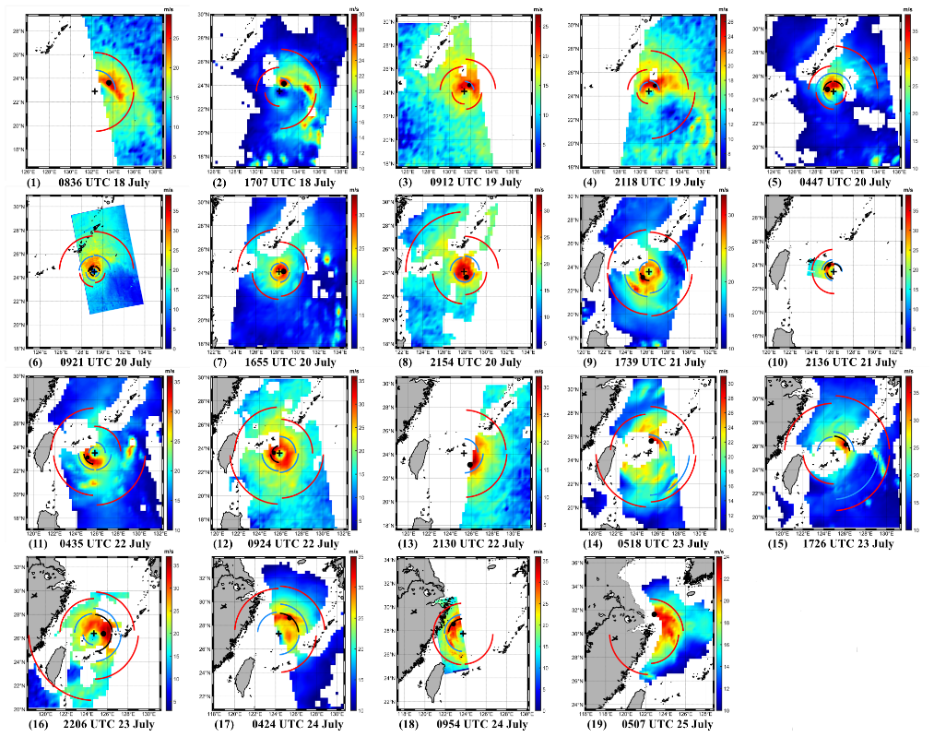
Observation and verification results
for Typhoon In-fa (2021)
Geographical locations of the 19 observed wind fields and the corresponding two-dimensional wind fields and extracted wind radii (R34, R50, R64) for In-fa. The blue cross shows the locations of the AWS data that were used.

Slide 14
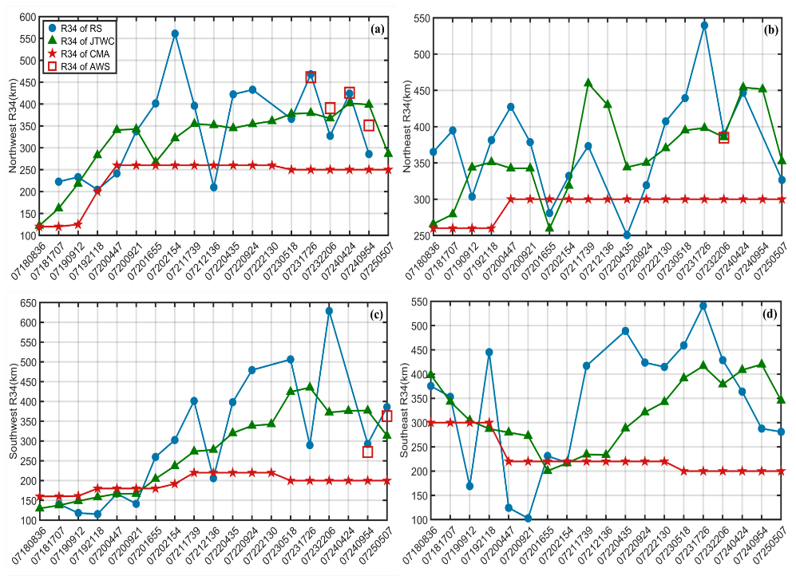
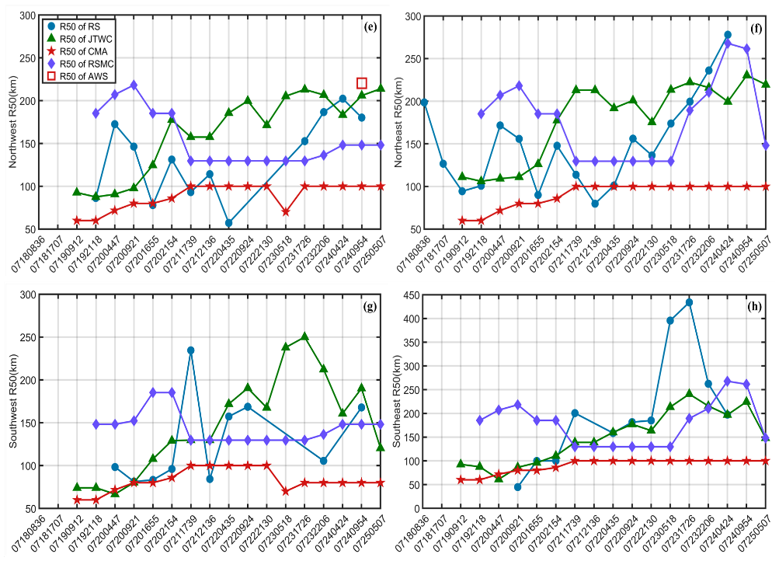
Observation and verification results
for Typhoon In-fa (2021)
The R34 and R50 values derived from satellite data are relatively close to those derived from JTWC data and show similar increasing trends to JTWC data. The R34 and R50 values recorded by AWSs are close to the values derived from satellite and JTWC data.

Slide 15
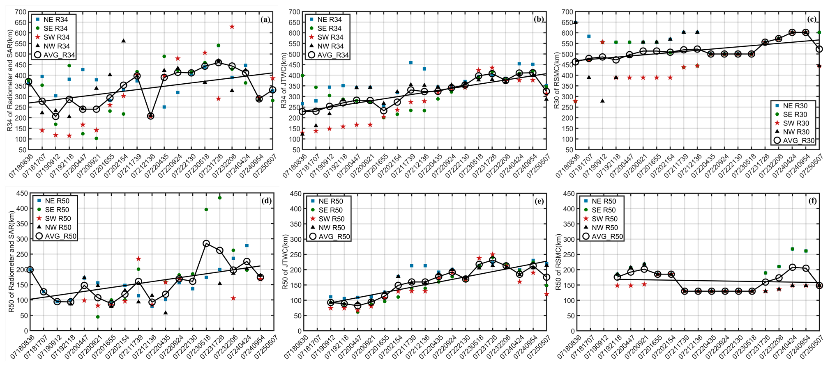
Observation and verification results
for Typhoon In-fa (2021)
The satellite and JTWC data both show that R34 has a clear increasing trend from TC formation to landfall, the RSMC R30 also shows an upward trend. The variation range of the linear regression fits for the RSMC AVG_R30 is significantly larger than that for the RS and JTWC AVG_R30.
The AVG_R50 time series from the satellite and JTWC data both show an upward tendency throughout the evolution of In-fa. There is no similar increasing tendency in the AVG_R50 time series from RSMC, which is primarily maintained at about 150 km.

Slide 16
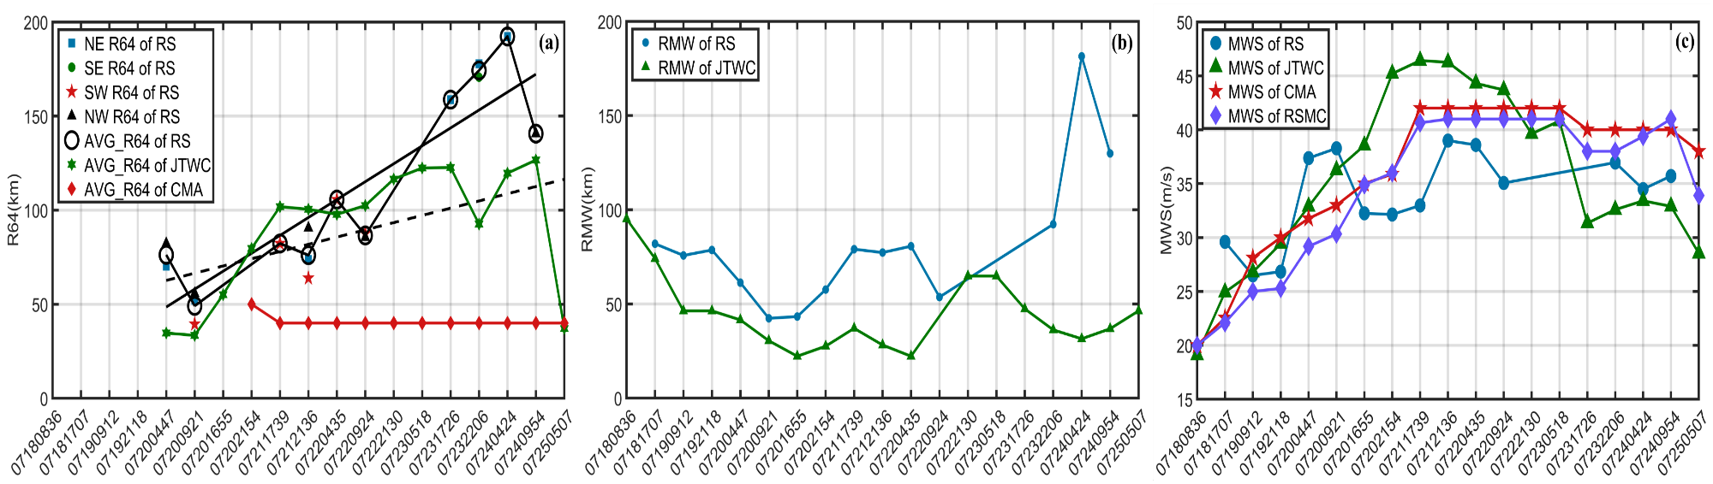
Observation and verification results
for Typhoon In-fa (2021)
Possible Sources of Errors：
The native resolution of the microwave radiometers；
The effect of rainfall on the C-band SAR signal when the wind speed is high;
Insufficient swath coverage and land pollution for radiometer data and the relatively narrow SAR swath ;
The estimation of wind radii in best-track data is subjective and depends on data availability and different analysis methods, real-time products rather than quality-controlled post-storm data
The R64 calculated from the satellite data is similar to that from the JTWC data in the early period but becomes larger before landfall and displays a clearer increasing trend.
In the early stages, the satellite and JTWC trends for RMW are similar, although the satellite RMW is somewhat larger than the JTWC RMW. Before In-fa made landfall, the R64 and RMW values from the satellite data were significantly greater than those from the JTWC data.

Slide 17
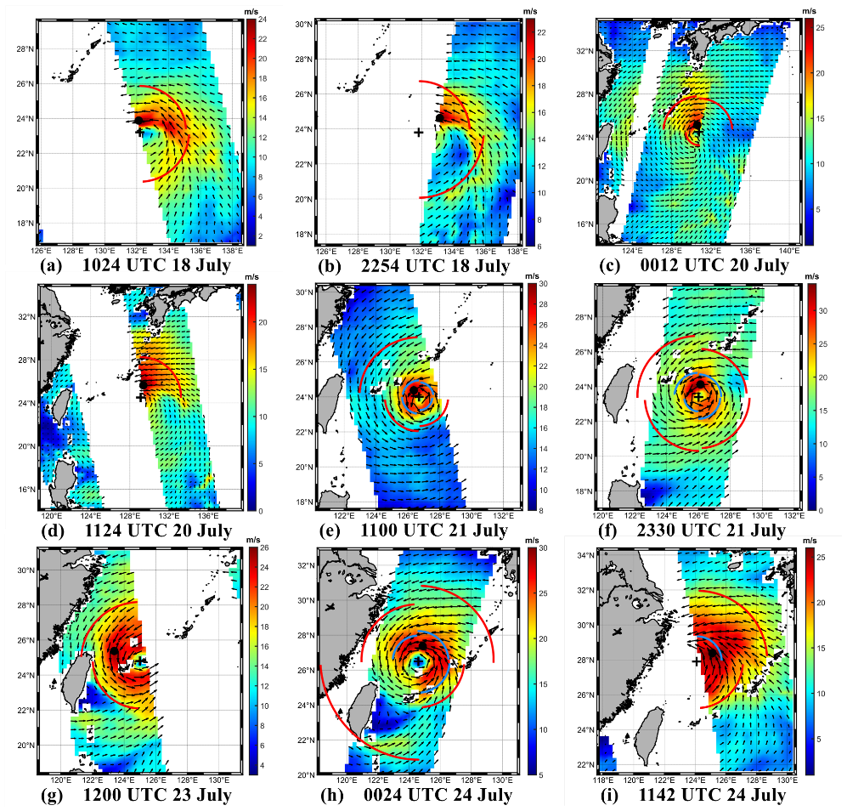
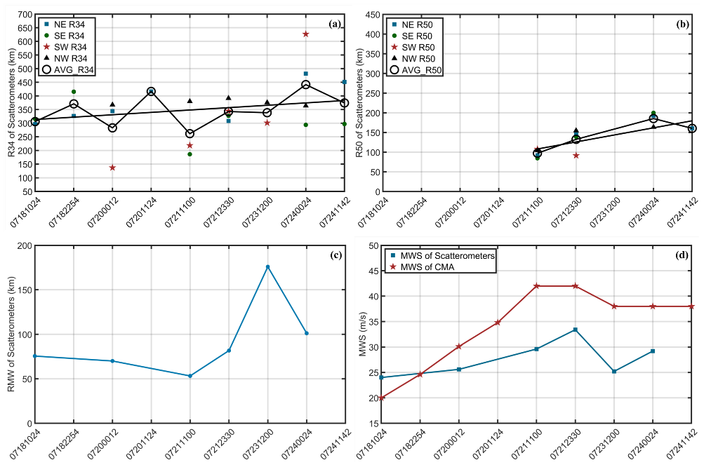
ASCAT observation and verification results for Typhoon In-fa (2021)
ASCAT is rather precise for analyzing outer wind radii (i.e., R34) of TCs (Chavas and Emanuel, 2010; Chan and Chan, 2012; Sampson et al., 2017).

Slide 18
Historical extreme of In-fa wind radii before landfall
CDFs for the average wind radii before In-fa made landfall, relative to 2001–2021 (2017–2021) JTWC wind radii records.
Data Source | AVG_R34 (km) | CDF for AVG_R34 | AVG_R50 (km) | CDF for AVG_R50 | AVG_R64 (km) | CDF for AVG_R64
RS | 400 | 0.98 (0.94) | 210 | 0.96 (0.90) | 160 | 0.99 (0.99)
JTWC | 400 | 0.98 (0.94) | 210 | 0.96 (0.90) | 120 | 0.95 (0.90)
The average wind radii before landfall derived from the RS and JTWC data all exceeded 95% of the 2001–2021 historical average wind radii records from JTWC. In particular, the AVG_R34 values from both RS and JTWC were likely in the 98th percentile of the historical AVG_R34 records from JTWC, indicating that the vortex structure of In-fa before landfall was extraordinarily large and represents a historical extreme.

Slide 19
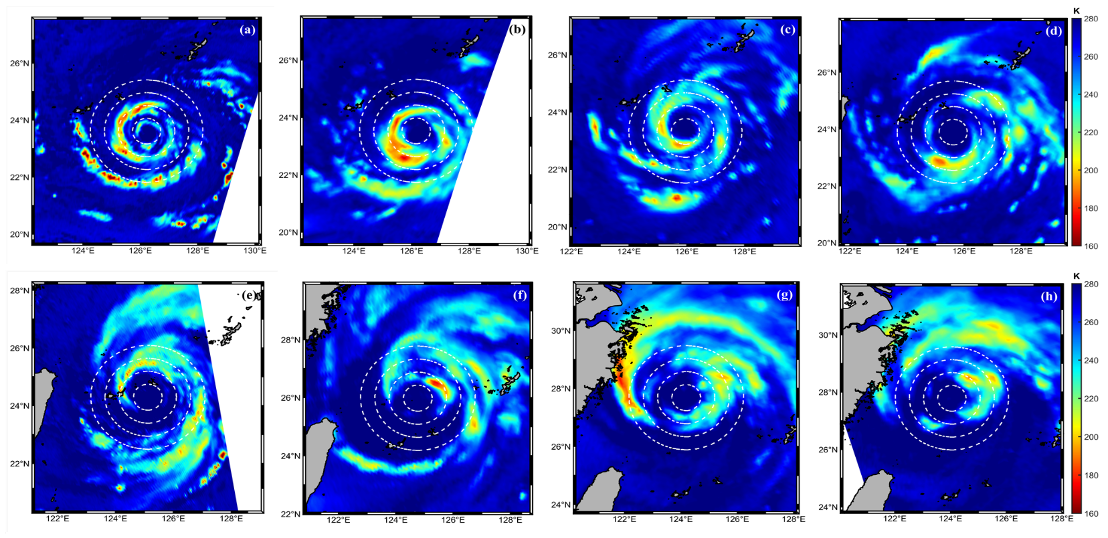
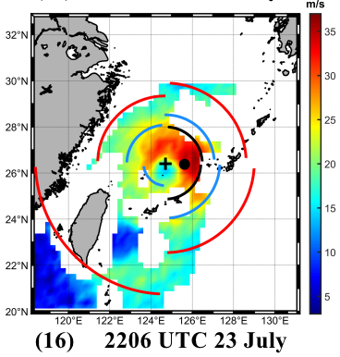
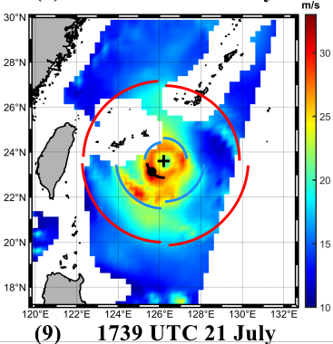
Discussion results
Concentric
Eyewall
Eyewall
Replacement
Storm-centered 85–92 GHz microwave brightness temperature (K) for In-fa recorded in AMSR2，SSMIS-16，17 imagery. White dashed circles indicate radial rings at 50 km intervals.

Slide 20
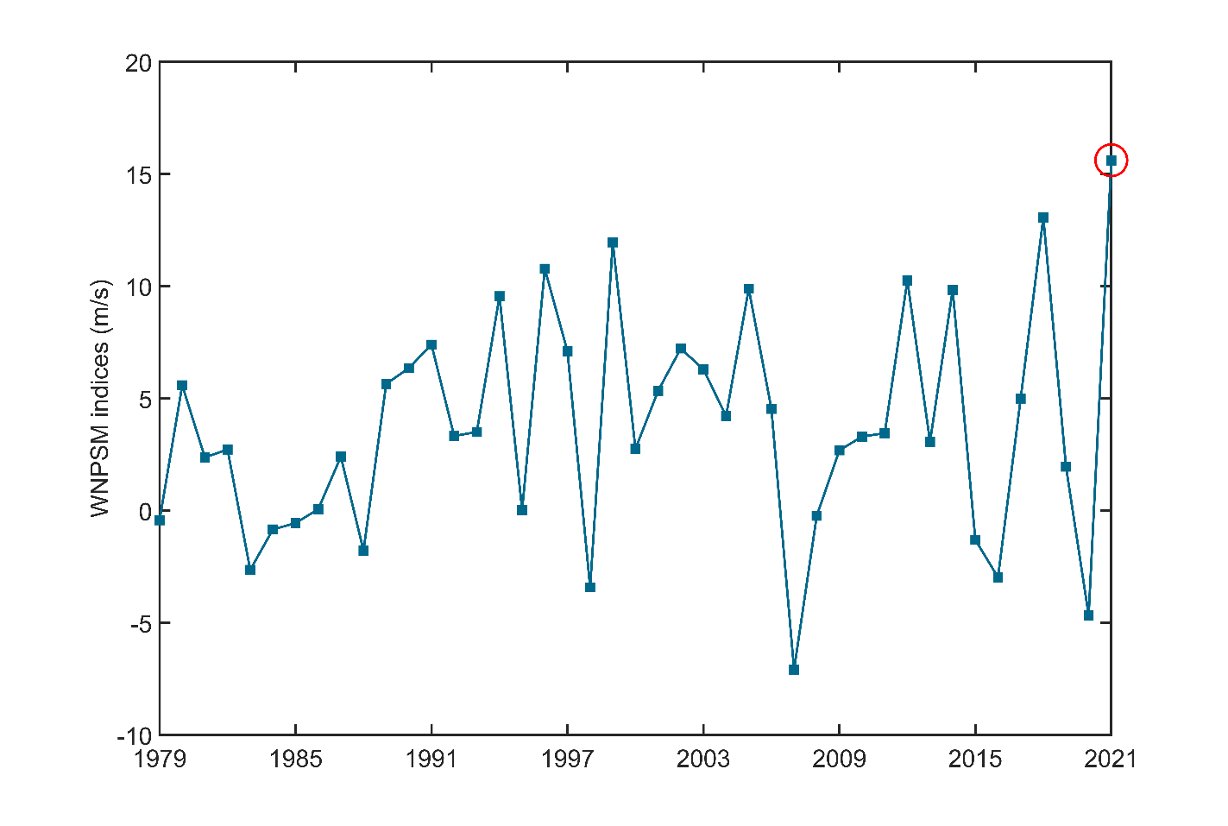
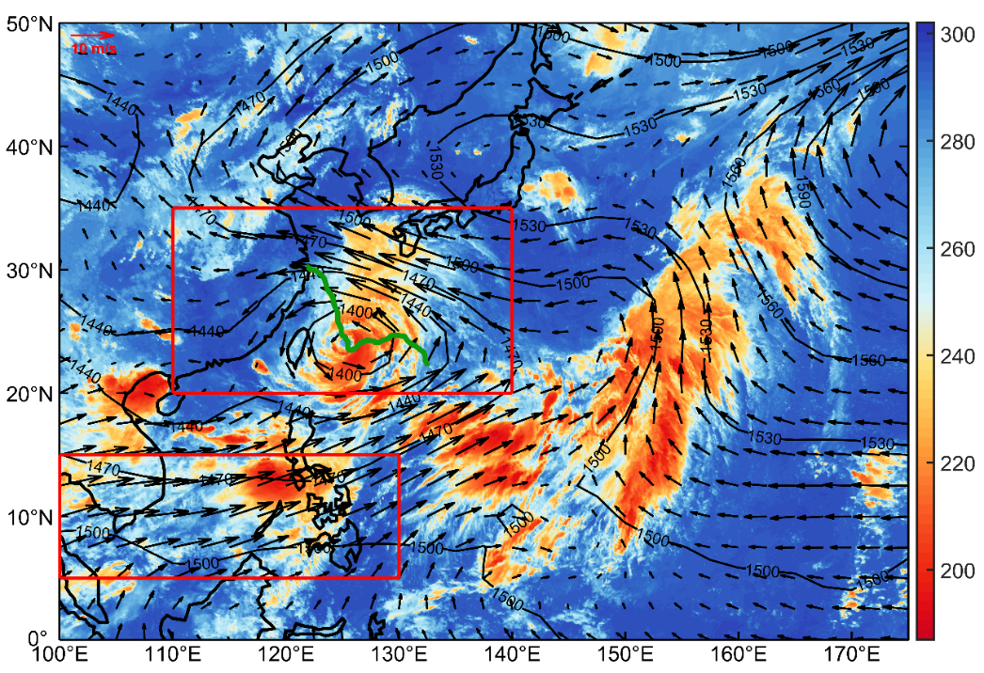
Discussion results
Time series of the average WNPSM index for 18–25 July from 1979 to 2021 and the 18–25 July 2021 averaged 850-hPa geopotential height (contoured in m) and wind (vectors) with infrared brightness temperature (shaded in K) for 0000 UTC 23 July 2021.

Slide 21
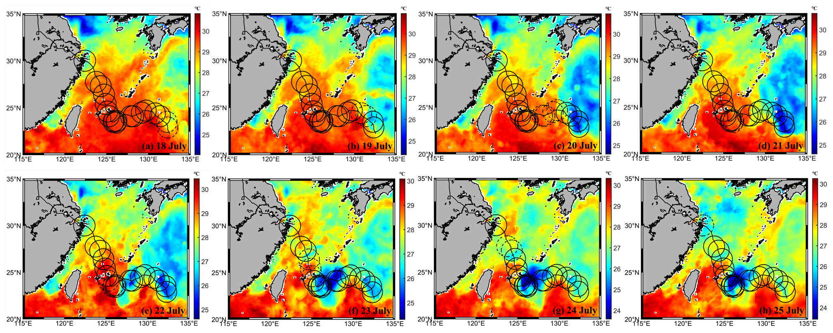
Discussion results
Daily average SST (shaded) for In-fa, from genesis to first landfall (July 18 to July 25). The dates are shown at the bottom of panels (a)–(h).

Slide 22
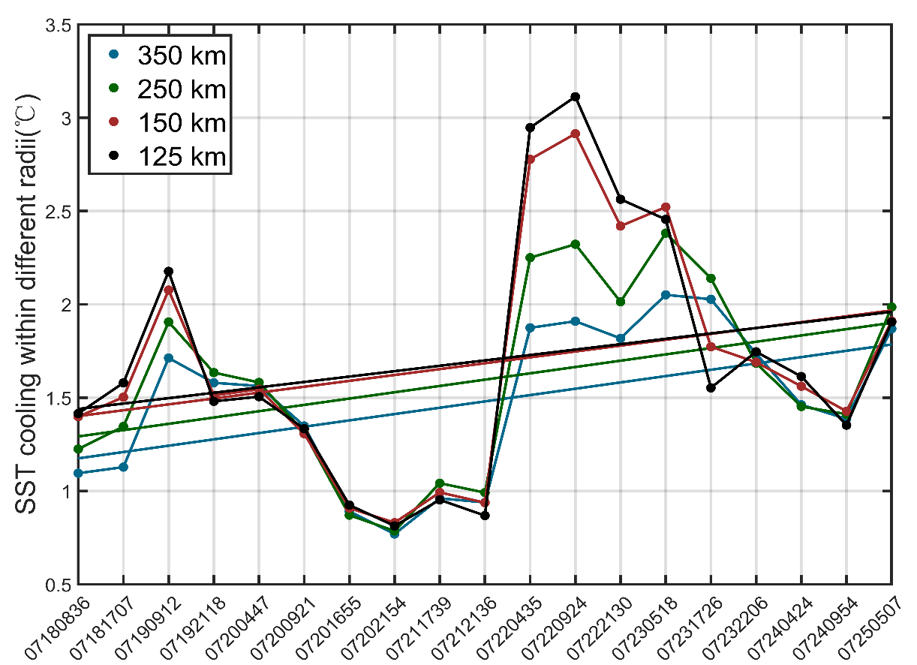
Discussion results
In-fa produced a significant SST cooling after it turned, and the average SST cooling in the inner core of In-fa (within a 125 km radius of the TC center) exceeded 3℃. As In-fa gradually accelerated northward, the degree of SST cooling weakened.

Slide 23
Main conclusions
The retrieved wind radii are relatively close to those from the Joint Typhoon Warning Center (JTWC), the coastal automatic weather stations in China, and the advanced scatterometer.
The time series for the wind radii show significant increasing trends during the lifecycle of In-fa and a massive vortex structure before In-fa made landfall.
The average wind radii observed before landfall are all likely in the 90th percentile of the 2001–2021 JTWC historical wind radii records, indicating that the vortex structure is extraordinarily large before In-fa made landfall and represents a historical extreme. The extremely large vortex structure may be attributable to the interaction between In-fa and an extremely strong monsoon gyre.
Microwave remote sensing data from multiple sources can provide a long-time series of accurate TC surface wind observations and assimilating these surface wind observations into operational TC forecasting helps to provide more realistic and reliable wind radii for use by emergency managers and downstream applications.
Z. Sun, L. Bai, X. Zhu, et al., The extraordinarily large vortex structure of Typhoon In-fa (2021), observed by spaceborne microwave radiometer and synthetic aperture radar, Atmospheric Research (2023), https://doi.org/10.1016/ j.atmosres.2023.106837

Slide 24
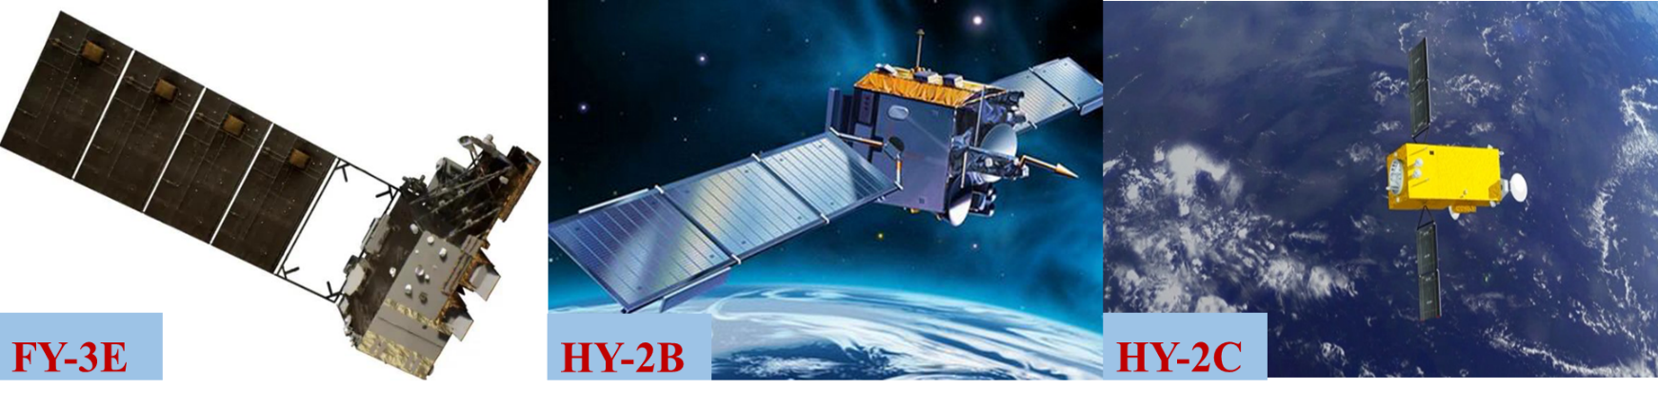
Thank you for your attention!
ESCAP/WMO Typhoon Committee 18th Integrated Workshop / 4th TRCG Forum，Bangkok, Thailand，28 November - 1 December 2023

